Slide 1

U.S. Healthcare
Time for Change
Thanks to Jim Kahn, Laurel Lucia, John Cassidy , Charlene Harrington, PNHP and others for sharing slide material. This presentation is dedicated to healthcare champions Pat Snyder and Dan Hodges.

Slide 2
The cost of healthcare in the U.S. is unsustainable
We pay twice as much as countries with good universal care
Tens of millions are forced into debt
Many have no insurance

Slide 3
Major questions to consider:
What should the goals of our healthcare system be?
What kind of system do we have? How did we get here?
What model would be better?
How might change be achieved in California?
What are the next steps?

Slide 4
What should the goals of our healthcare system be?

Slide 5
“The enjoyment of the highest attainable standard of health is one of the fundamental rights of every human being without distinction of race, religion, political belief, economic or social condition” Constitution of the World Health Organization
System Goals
Universal
Comprehensive
Equitable
Effective
Affordable
Notes:
Briefly, how many of these goas are we achieving today? Definitely not universal or equitable, but definitely effective and affordable FOR SOME. Why for some and not others? Quality of insurance .

Slide 6
What kind of system do we have? How did we get here?

Slide 7
Where Californians get their insurance

Slide 8
Following the violent death of United Healthcare CEO, Brian Thompson on December 4, 2024, his successor, Andrew Witty, wrote in the NYTimes:
“We know the health system does not work as well as it should, and we understand people’s frustrations with it. No one would design a system like the one we have. And no one did. It’s a patchwork built over decades.”

Slide 9
U.S. Healthcare History
Prior to the 1920s most people didn’t seek medical care for common ailments
In 1929 – Premiums to Blue Cross and Blue Shield paid doctors in lumber / mining camps
In 1940s – Kaiser developed to serve dam workers- 60 MDs.
Employer sponsored insurance became more common.
Truman proposed a single-payer healthcare plan but the AMA opposed it
By 1960s and 70s- There were 900 different insurance companies.
Many had no insurance or were denied coverage.
Administration costs were up to 30% of the costs.
Insurance covered only 16% of costs other than hospital and MD bills
1965 - Medicare and Medicaid introduced by Lyndon Johnson
1973 The Health Maintenance Organization Act, promoted HMOs and allowed profit by investment in insurance companies. This spurred growth of for-profit insurers

Slide 10
U.S. Healthcare History (continued)
2003 First Medicare for All Act introduced by John Conyers.
George Bush promoted corporate involvement in Medicare with Medicare Advantage and prohibited Medicare from negotiating drug prices
2010 Affordable Care Act (ACA) attempted to get more people insured. It prohibited coverage denials on the basis of preexisting conditions. It required coverage of essential benefits.
Continued high co-pays and deductibles for many. Individual mandate to get insurance
2011 Vermont passed the first Single Payer Bill. Undermined by lack of funding.
2017 Trump administration repealed the ACA individual mandate
2024 Profits soared. United Health, the largest conglomerate of private health insurers, had a 11% profit ; Kaiser increased price of insurance 13% in one year
TODAY -75% of MDs work for corporations.
-Half of Medicare patients are enrolled in Medicare Advantage plans, increasingly “for-profit”
-Healthcare costs are the major cause of bankruptcy in the U.S
-The U.S. ranks 55th in the world for maternal mortality, the worst of any developed nation
-Millions in the U.S. have to forgo health care due to costs.

Slide 11
How does the U.S. compare to other countries ?
Cost of healthcare by country per capita (2018 data)

Slide 12
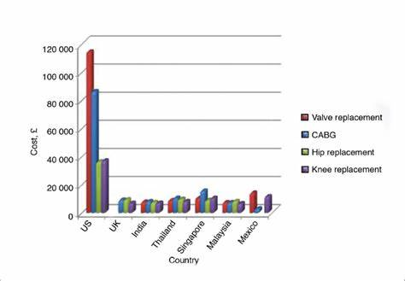
2018 costs for different procedures
(CABG is coronary bypass surgery)

Slide 13
Pharmaceutical Prices in the U.S. vs. Other Countries
US pays at least 3x more than other countries
DRUG COST IN U.S. COST IN OTHER COUNTRY(S)
Sovaldi (for hepatitis C) $84,000 for a 12-weeks India < $1,000
Humira (autoimmune ) $77,000 a year. Canada/UK $25,000
Epipen (allergic reactions) up to $ 600 for a two pack Other countries < $100
Insulin (for diabetes) $ 400 non-Medicare Other countries $30-$50
Cymbalta (antidepressant) $ 300 a month Germany $30
Ozempic / Wegovy $ 900-$1,200 a month Canada/UK $200-$400
Notes:
U.S. is 3.22 times higher

Slide 14
Is this sustainable?

Slide 15
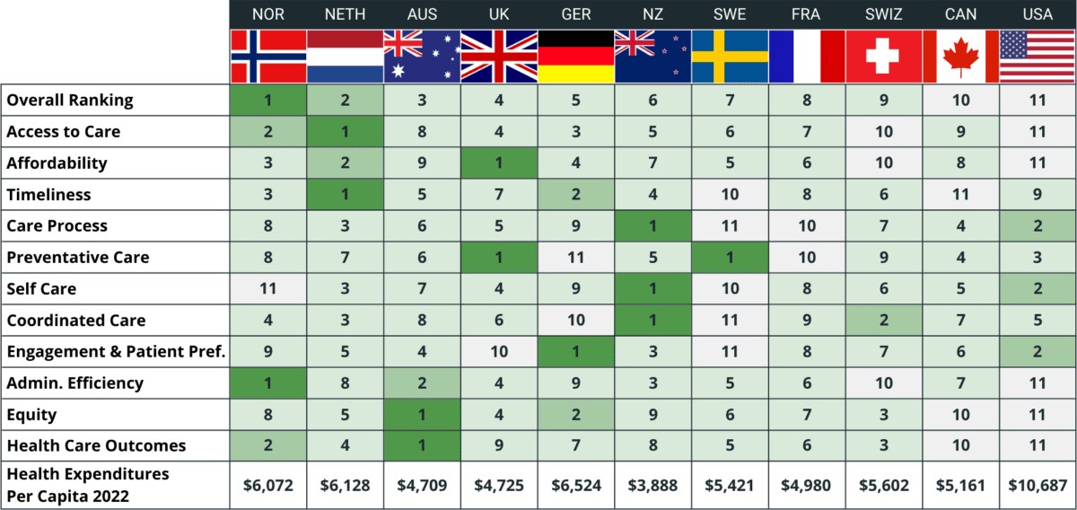
International Healthcare Rankings (2023)
The U.S. ranks last overall, with lowest marks in access, affordability, efficiency, equity and outcomes

Slide 16
U.S. Life Expectancy Behind Other Nations
Source of data: OECD.Stat, Accessed December 29, 2023.

Slide 17
US Maternal Mortality almost doubled since 2000
157 other countries have, on average, cut it in half
(Maternal mortality = maternal deaths per 100,000 births)

Slide 18
Medical Bills and Debt
Any medical bill
or debt problem
“Had problems paying or
unable to pay medical bills”
“Medical bills/debt
being paid over time”
“Contacted by collection agency
for unpaid medical bills”
“Had to change way of life
to pay medical bills”
Source: Collins S, Haynes L, Masitha R. The State of U.S. Health Insurance in 2022. Commonwealth Fund [Internet]. 2022 Sep 29 [cited 2022 Nov 2]; Available from: https://www.commonwealthfund.org/publications/issue-briefs/2022/sep/state-us-health-insurance-2022-biennial-survey

Slide 20
Is high cost due to amount of care?
Patients in U.S. have fewer MD visits than in other countries

Slide 21
Despite high premiums, 60% of insured say they have problems with their health insurance:
Insurance paid less than expected
Needed doctor but they didn’t have appointment
Prescription wasn’t covered or very high co-pay
Insurance didn’t cover something thought it would

Slide 22
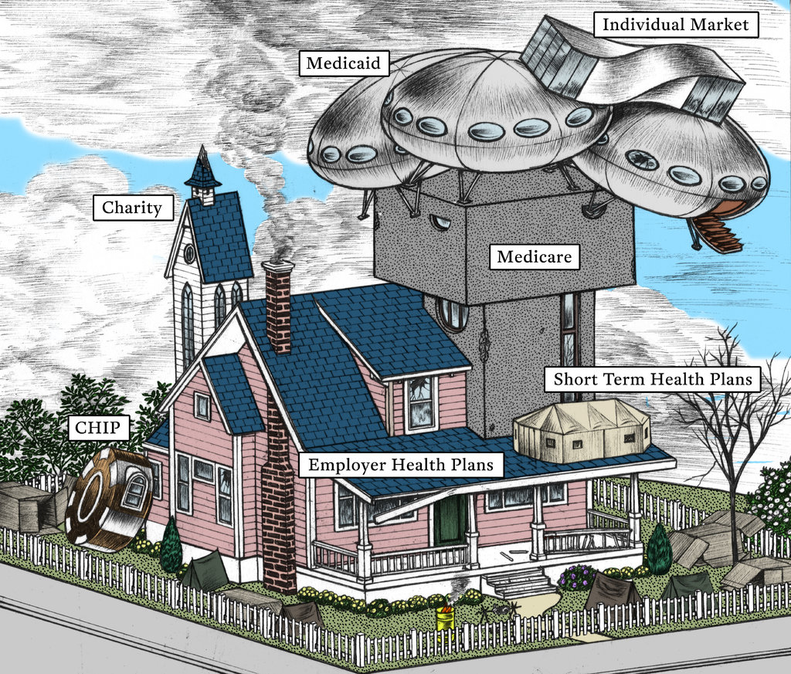
Our current system is profit-driven, fragmented and complex
Difficult to navigate system
High administrative costs

Slide 23
Increasing trend toward privatization and profit, making healthcare more expensive

Slide 24
Global Healthcare Private Equity Deals
Investors in Medicare Advantage
Redrawn figure from Bain & Company. Global Healthcare Private Equity and M&A Report 2023 [Internet]. [cited 2023 Nov 6].
Available from: https://www.bain.com/insights/topics/global-healthcare-private-equity-ma-report/

Slide 25
Marketing results in increase in sign-ups for privatized Medicare Advantage
Quality is not necessarily better
PROFIT IS BEING
MADE FROM
GAMING THE MEDICARE
SYSTEM
MA plans receive higher overall payments from the Federal system than Traditional Medicare because there are more people enrolled
Medicare Advantage beneficiaries use less healthcare than Traditional Medicare beneficiaries
Notes:
Providers are paid the same for Traditional Medicare as for Medicare Advantage. Medicare Advantage investors can get a “cut” of any excess revenue, so…

Slide 26
HOSPICE CARE is becoming a for-profit business
For-profit hospices more likely ranked as low-performing due to staff and cost cutting
Percentage of hospices ranked as low-performing by family assessments of care
Low-performing defined as hospices with a CAHPS Hospice Survey score 3 points or more below the national average. Data from: Anhang Price R, Parast L, Elliott MN, et al. Association of Hospice Profit Status With Family Caregivers’ Reported Care Experiences. JAMA Internal Medicine 2023;183(4):311–8.
Notes:
Medicare pays hospice agencies a daily rate regardless of the number of services provided on a given day, including days when the hospice provides no services

Slide 27
Insurance administrative costs are huge
Duke Medical Center:
957 beds
1600 billing clerks
Notes:
Administrative costs add up …

Slide 29
What model would be better ?

Slide 31
Single Payer Fundamentals
Healthcare dollars (Medicaid, Medicare, income and employer taxes) pooled
Providers paid by single payer agency
No insurance premiums
Reduced or no co-pays/deductibles
Reduced administrative costs
Ability to bargain for cheaper drug and medical devices
Healthcare not tied to employment
Private and public care continues in a variety of settings

Slide 32
Single Payer Fundamentals (continued)
Transition over a number of years.
Retraining for insurance workers
Professional committee to oversee standards set prices support geographic and staffing needs
Coverage is comprehensive : vision, dental, mental health, long term care from birth to death

Slide 33
There is support for a single-payer system
More than half of U.S. physicians support a single payer healthcare system
The 2023 California Healthy California for All Commission concluded that there would be substantial cost savings and more equitable healthcare
In 2017, the Public Policy Institute of California found that 56% of likely voters surveyed supported the creation of a “single state government health plan.”
A growing number of businesses and institutions realize they could save money with a single-payer system.
Notes:
(1 Merritt Hawkins survey.) , with 42% “strongly” in favor and another 14% "somewhat" supportive.
2coverage from a unified health care financing system.
3“guaranteed health insurance coverage” from 4 now paying for expensive insurance policies for employees

Slide 34
How might change be achieved in California?

Slide 35
LEGISLATION is needed
We need legislation passed by Assembly and Senate and signed by the Governor
Past bill campaigns have increased awareness and support
More public education and pressure on legislators

Slide 36
To summarize,
California single payer legislation would :
Establish a state insurance plan from birth to death
Include coverage for medically necessary services PLUS oral health, audiology, vision services and
long-term care
No premiums, deductibles, co-pays, pre-authorizations
Provide retraining for those in the insurance industry
Allow for negotiation of better drug and supply prices

Slide 37
Costs for CA health care (2017) = $368 billion
+Add $ 36 billion
-to cover all CA residents
-to cover comprehensive benefits
- Deduct $73 billion projected savings
- administrative waste
- excessive prices
- drugs, provider fees
- fraud, other service reforms
----------------------------------------------------------------------------------------------------------------------------------------------
Estimated cost for single-payer health care = $331 billion
*****Savings = $37 billion

Slide 38
How would a single payer plan be financed?
By a public Trust Fund, with money from federal and state government agencies and progressive payroll and income taxes
Taxes would replace and be less than the amount now paid for private insurance plan premiums, deductibles and co-pays

Slide 39
How can the State capture the necessary Federal Medicaid and Medicare funding?
A waiver must be granted from the federal government
This waiver must be requested by the Governor of California from the U.S. Health & Human Services

Slide 40
What are the Next Steps?
Stay informed (Health Justice Monitor, Kaiser Family Foundation)
Educate legislators, friends, community, care providers
Advocate for legislation
Support good politicians
Join in solidarity and activism with others (e.g. HCA, PNHP, CA Alliance for Retired Americans (CARA), Common Cause)
Notes:
. Learn about the situation in the U.S. and how healthcare is paid for and provided in other countries. Stay informed about what other states are proposing and the legislation being proposed at the national level. Subscribe to Health Justice Monitor (hjm.net) and Kaiser Family Foundation newsletter (KFF.org)
2) about the reality of our current healthcare financing system and alternatives. Remind them that other countries have radically changed how they finance health care and that this has resulted in a better system.
3) to reduce corporate influence on elections and profiteering from healthcare.
4) who make equitable, efficient, high-quality healthcare a goal.
5) such as HCA-CA, PNHP, CARA, Common Cause to receive information and to achieve change

Slide 41
Thank you!
Questions?

